Slide 1

PYTHON
NEW VERON PLANE
SI

Slide 2
USE OF ALL PROGRAMMING LANGUAGES
FIRST OF ALL WE USE JAVA (THE DIFFICUILT ONE)
JAVA(BREAKING IT INTO MODULES)

Slide 3

JAVA
THEN WE SEE WHICH PARTS PERFECTLY FIT
AT FIRST USE IT WITH OLD VERSION OF PYTHON
MODULES OF JAVA
THEN MATCH IT WITH C++ FOR USE
AT LAST WE TAKE JAVA THAT ONE MODULE WICH IS HIGLY SIMILAR TO PYTHON TO JOIN THEM
THEN WITH OTHER ONE TO SEE IF IT ACTUALLY WORKS

Slide 4
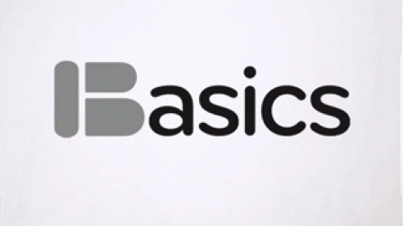
BASIC
AT FIRST AT SAME AS JAVA WE DIVIDE INDO MODULES THEN MATCH IT WITH BOTH PYTHON AND JAVA
AFTER THAT WE POINT TE SIMILARITY BETWEEN THE THE JAVA AND BASIC TO MEET THE REQUIREMENT
THEN WE FIND EXACT SIMILAR POINT BETWEEN THREE OF THEM
AT SECOND WE WILL USE BASIC BECAUSE IT IS USED BY THE STUDENTS TO SOLVE SIMPLE PROBLEMS ON COMPUTER .

Slide 5

COBOL
IT IS THE LANGUAGE THAT IS USED FOR BUISNESS PURPOSES AND FOR BUISNESS APPLICATIONS TO MAKE BUISNESS MORE RELIABLE AND EASY TO TYPE BUISNESS DOCUMENTS .
BUISNESS ORIENTED LANGUAGE IF ADDED WITH PYTHON MAKES PYTHON USABLE FOR BUISNESS PURPOSE

Slide 6


FORTRAN
IF WE USE IT WITH PYTHON WE CAN MAKE PYTHON MORE RELIABLE FOR STUDENTS TO SOLVE COMPLEX FOR MULAS
IT HAS VERY POWERFUL MATHEMATICAL CAPABILITIES THE STUDENTS OF MATHEMATICS THAT ALSO KNOW COMP SCI USE IT .

Slide 7
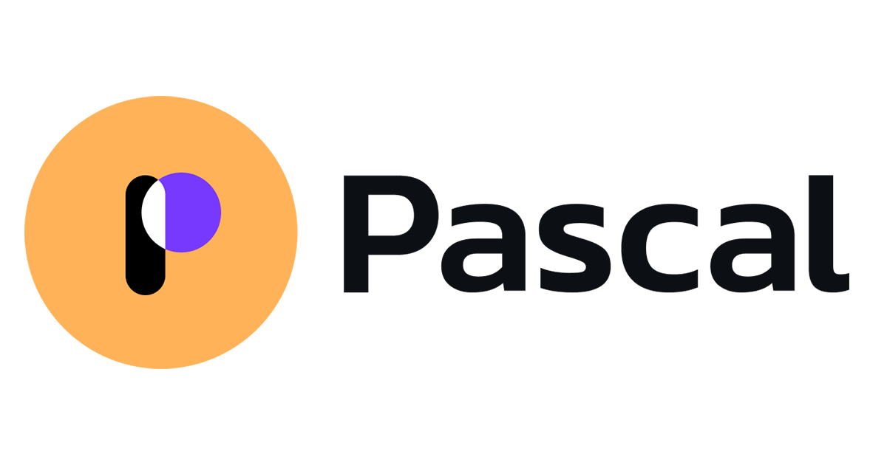
PASCAL
AS WE ALL KNOW PASCAL IS THE UNIT OF PRESSURE AND ALSO IT IS A PROGRAMMING LANGUAGE USED FOR SCIENTIFIC AND BUISNESS APPLICATIONS
IF WE USE PASCAL WITH PYTHON ITS VERY USEFUL FOR DEVELOPING SOFTWARE IN SCINTIFIC APPLICATIONS AND BUISNESS APPLICATIONS

Slide 8


B AND C
1.AS WE KNOW THAT B LANGUAGE DONOT HAVE TYPING DESIGN IT ONLY HAVE DIRECT MEMORY WE USE IT AS CONCEPT TO DESIGN ANOTHER VERSION OF PYTHON. 2.BY USING B PYTHON WILL BECOME MORE RELIABLE AND BY USING C++ WE CAN SOLVE THE PROBLEM OF SPEED . 3.JAVA MODULES AND PYTHON AND ADDING ALL THE PRO GRAMMING LANGUAGES IT IS GOOD. 4.WE ALSO KNOW THAT C LANGUAGE IS FLEXIBLE AND 2ND EARLIER LANGUAGE SO BY USING BOTH WITH .

Slide 9
CONCLUSION
1.NOW MY FINAL PLANE IS THAT IF WE USE ALL TYPES OF PROGRAMMING LANGUAGES TO BUILT ANOTHER VERSION OF PYTHON. 2.IT WILL BE NOT ONLY EASY BUT ALSO IS GOING TO BE USEFUL IN BUILDING ALL TYPES OF APPLICATIONS. 3.IT ALSO SAVES US FROM THE DIFFICUILTY OF USING OTHER PROGRAMMING LANGUAGES. 4.BY UNDERSTANDING DIFFERENT ASPECTS AND IT PRODUCES MAJOR DIFFICUILTY. 5.IF WE CREATE THIS VERSION IT WILL BE TOO EASY FOR EVERYONE. 6.BY USING ONLY ONE LANGUAGE TO CREATE DIFFERENT APPLICATIONS AND ALSO SAVES A LOT OF TIME. 7.WE USE ALL MAJOR ASPECPTS OF THESE PROGRAMMING LANGUAGES. 8.BY USING C AND OLDEST ONE B AND C++ AND JAVA MODULES (DIVISION OF JAVA IN PARTS) . 9.ALL OTHER LANGUAGES AS I MENTIONED EARLIER IT WILL BE A GREAT BLESSING AND BEST FOR THE PROGRESS OF TECHNOLOGICAL WORLD
HF

